Slide 1
Design and Analysis of Algorithms
DAA - Unit - I Presentation Slides

Slide 2
MODULE – I
Notion of an Algorithm – Fundamentals of Algorithmic Problem Solving – Important Problem Types – Fundamentals of the Analysis of Algorithm Efficiency – Analysis Framework – Asymptotic Notations and its properties – Mathematical analysis for Recursive and Non-recursive algorithms.
DAA - Unit - I Presentation Slides

Slide 3
Text & Reference Books - DAA
SI.No | Author(s) | Title of Book | Publisher | Year of Publication
DAA I | Cormen T H, Leiserson C E, Rivest RL , Stein C | Introduction to Algorithms | MIT Press, Third Edition | 2009
DAA II | Anany Levitin | Introduction to Design and Analysis of Algorithm | Pearson Education | 2011
DAA - Unit - I Presentation Slides

Slide 4
What is an algorithm?
An algorithm is a list of steps (sequence of unambiguous instructions ) for solving a problem that transforms the input into the output.
problem
algorithm
input
“computer”
output
DAA - Unit - I Presentation Slides

Slide 5
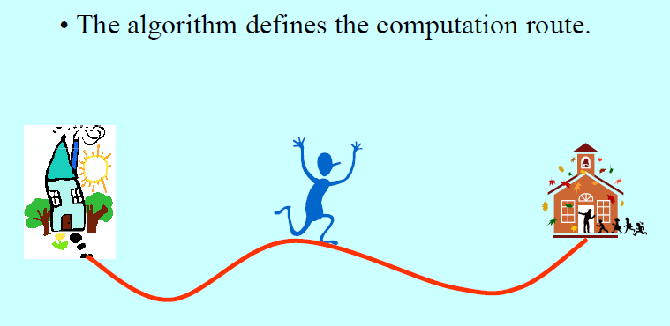
Algorithm
DAA - Unit - I Presentation Slides

Slide 6
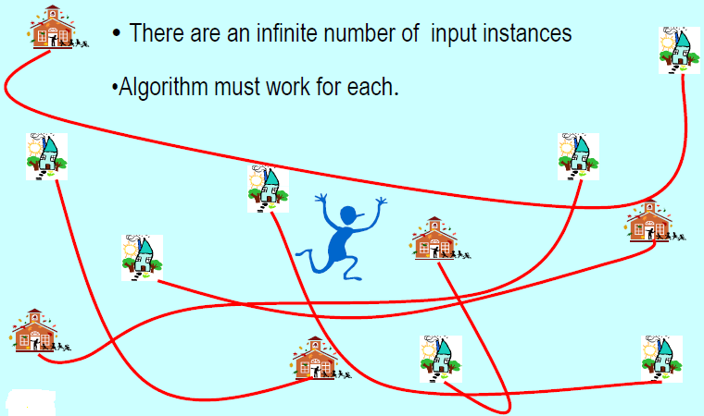
Complexity
DAA - Unit - I Presentation Slides

Slide 7
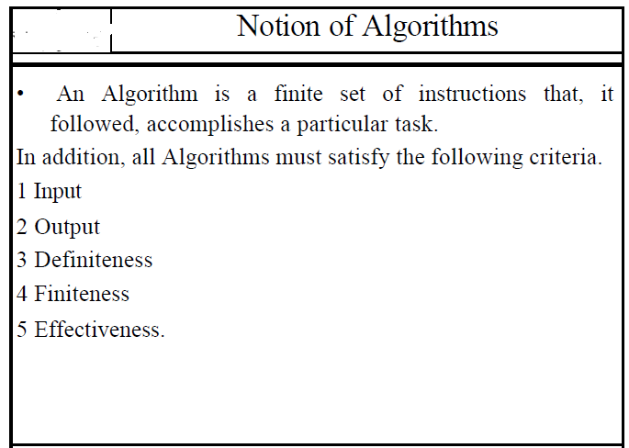
DAA - Unit - I Presentation Slides

Slide 8
Characteristics of Algorithm
Inputs:
An algorithm has zero or more but only finite, number of inputs.
DAA - Unit - I Presentation Slides

Slide 9
Characteristics of Algorithm
Output:
An algorithm has one or more outputs. The requirement of at least one output is obviously essential, because, otherwise Effectiveness cannot know the answer/ solution provided by the algorithm. The outputs have specific relation to the inputs, where the relation is defined by the algorithm
DAA - Unit - I Presentation Slides

Slide 10
Characteristics of Algorithm
Definiteness (no ambiguity):
Each steps of an algorithm must be precisely defined; the action to be carried out must be rigorously and unambiguously specified for each case.
DAA - Unit - I Presentation Slides

Slide 11
Characteristics of Algorithm
Finiteness:
An algorithm must terminate after a finite number of steps and further each step must be executable in finite amount of time that it terminates (in finite number of steps) on all allowed input.
DAA - Unit - I Presentation Slides

Slide 12
Characteristics In short … Cont.,
Precision – the steps are precisely stated
Uniqueness – results of each step are uniquely defined and only depend on input and result of the preceding steps.
Finiteness – the algorithm stops after a finite number of instructions executed.
Input – the algorithm receives input.
Output – the algorithm produces output.
Generality – the algorithm applies to a set of inputs.
DAA - Unit - I Presentation Slides

Slide 13
PROPERTIES OF AN ALGORITHM
An algorithm takes zero or more inputs
An algorithm results in one or more outputs
All operations can be carried out in a finite amount of time
An algorithm should be efficient and flexible
It should use less memory space as much as possible
An algorithm must terminate after a finite number of steps.
Each step in the algorithm must be easily understood for some reading it
An algorithm should be concise and compact to facilitate verification of their correctness.
DAA - Unit - I Presentation Slides

Slide 14
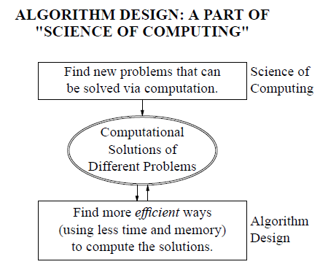
ALGORITHM
DAA - Unit - I Presentation Slides

Slide 15
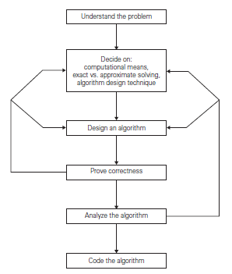
Fundamentals of Algorithm and Problem Solving
DAA - Unit - I Presentation Slides

Slide 16
Understanding the Problem
understand completely the problem given.
Read the problem’s description and ask clarifying doubts about the problem.
Try to identify few similar types of problems that arise in computing applications quite often.
If the solution is already exist, try to choose the possible known algorithm for solving it.
An input to an algorithm specifies an instance of the problem the algorithm solves.
It is very important to specify exactly the set of instances the algorithm needs to handle.
DAA - Unit - I Presentation Slides

Slide 17
Computational Device
Decide on the computational device the algorithm is intended for.
RAM Model Vs Parallel Machine
sequential algorithms Vs parallel algorithms.
Choose between solving the problem exactly or solving it approximately.
Exact algorithm Vs approximate algorithm.
Select the type of Data Structure
DAA - Unit - I Presentation Slides

Slide 18
Algorithm Design Techniques
An algorithm design technique (or “strategy” or “paradigm”) is a general approach to solving problems algorithmically that is applicable to a variety of problems
Some of the Strategies are:
  Brute Force Method
  Divide and Conquer
  Greedy
  Dynamic Programming
  Backtracking
DAA - Unit - I Presentation Slides

Slide 19
Methods of Specifying an Algorithm
Once the designing of an algorithm is completed, we need to specify it in some fashion.
There are three options for specifying algorithms.
  Natural Language Representation
  Pseudo Code
  Flowchart
DAA - Unit - I Presentation Slides

Slide 20
Proving an Algorithm’s Correctness
Once an algorithm has been specified, you have to prove its correctness.
Prove that the algorithm yields a required result for every legitimate input in a finite amount of time.
A common techniques:
  Use mathematical induction
  Use Trials
DAA - Unit - I Presentation Slides

Slide 21
Analysing an Algorithm
After correctness, by far the most important is efficiency.
In fact, there are two kinds of algorithm efficiency: time efficiency, indicating how fast the algorithm runs, and space efficiency, indicating how much extra memory it uses.
Other desirable characteristic of an algorithm:
  Simplicity
  Generality
DAA - Unit - I Presentation Slides

Slide 22
Coding an Algorithm
Most algorithms are destined to be ultimately implemented as computer programs.
Programming an algorithm needs to choose a particular programming language and transforms into absolute code.
DAA - Unit - I Presentation Slides

Slide 23
Notion of Algorithm: Euclid’s Algorithm
Problem: Find gcd(m,n), the greatest common divisor of two nonnegative, not both zero integers m and n
Examples: gcd(60,24) = 12, gcd(60,0) = 60, gcd(0,0) = ?
Euclid’s algorithm is based on repeated application of equality
  gcd(m,n) = gcd(n, m mod n) (OR)
(ii) gcd(m, n) = gcd(m − n, n) for m ≥ n > 0.
until the second number becomes 0, which makes the problem
trivial.
Example: gcd(60,24) = gcd(24,12) = gcd(12,0) = 12
gcd(60,24) = gcd(36,24) = gcd(12,24)
DAA - Unit - I Presentation Slides

Slide 24
Two descriptions of Euclid’s algorithm
Step 1 If n = 0, return m and stop; otherwise go to Step 2
Step 2 Divide m by n and assign the value of the remainder to r
Step 3 Assign the value of n to m and the value of r to n. Go to
Step 1.
while n ≠ 0 do
r ← m mod n
m← n
n ← r
return m
DAA - Unit - I Presentation Slides

Slide 25
Other methods for computing gcd(m,n)
Consecutive integer checking algorithm
Step 1 Assign the value of min{m,n} to t
Step 2 Divide m by t. If the remainder is 0, go to
Step 3; otherwise, go to Step 4
Step 3 Divide n by t. If the remainder is 0, return t and stop; otherwise, go to Step 4
Step 4 Decrease t by 1 and go to Step 2
Is this slower than Euclid’s algorithm? How much slower?
DAA - Unit - I Presentation Slides

Slide 26
Other methods for gcd(m,n) [cont.]
Middle-school procedure
Step 1 Find the prime factorization of m
Step 2 Find the prime factorization of n
Step 3 Find all the common prime factors
Step 4 Compute the product of all the common prime factors and return it as gcd(m,n)
Is this an algorithm?
How efficient is it?
Time complexity: O(sqrt(n))
DAA - Unit - I Presentation Slides

Slide 27
Problem.
Find gcd(31415, 14142) by applying Euclid’s algorithm
DAA - Unit - I Presentation Slides

Slide 28
Problem. Find gcd(31415, 14142) by applying Euclid’s algorithm
gcd(31415, 14142) = gcd(14142, 3131)
= gcd(3131, 1618)
= gcd(1618, 1513)
= gcd(1513, 105)
= gcd(1513, 105)
= gcd(105, 43)
= gcd(43, 19)
= gcd(19, 5)
= gcd(5, 4)
= gcd(4,1)=gcd(1, 0)=1.
DAA - Unit - I Presentation Slides

